Slide 1
Module 4 Attacks and Defenses
Section 7 – Hijacking the legitimate OS functions and components
June 2018

Slide 2
.
Section 7 – Hijacking the legitimate OS functions and components
Learning Objectives
Explain attacks:
Ransomware
Hijacking
RDP Hijacking
DLL Hijacking
Windows Restrictions Bypass
Identify countermeasures

Slide 3
Hijacking
Hijack refers to taking control over something and causing it to do something else.
The most common type of hijacking is when malware infects your computer and redirects your web browser, homepage, or search engine to a malicious site or somewhere you don't want to be.
Malware and especially ransomware may use standard OS functions and features, if they have privilege to do it, in order to attack the system.
There are multiple example of these attacks, and we will spend time on Wannacry/Petya.

Slide 4
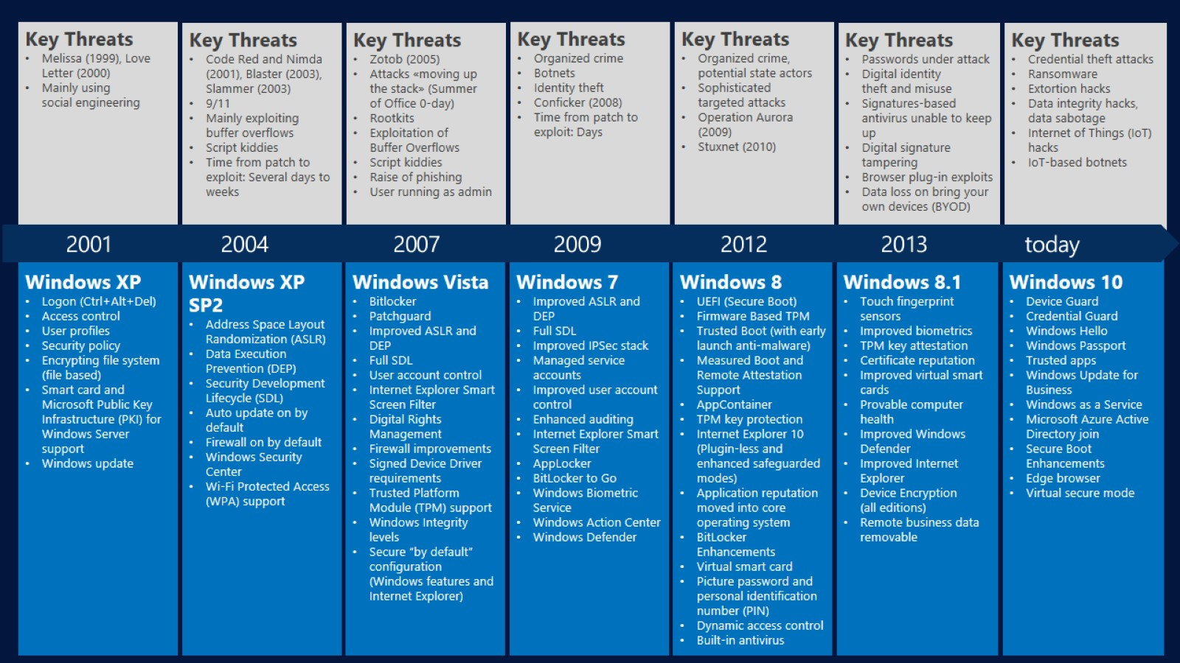
System and Threat evolution

Slide 5
RansomWares Examples

Slide 6
RansomWares (Petya, NotPetya, BadRabbit, wannacry)
Initial attack using component vulnerabilities
Lateral movement rely on components weakness and identity thief.

Slide 7
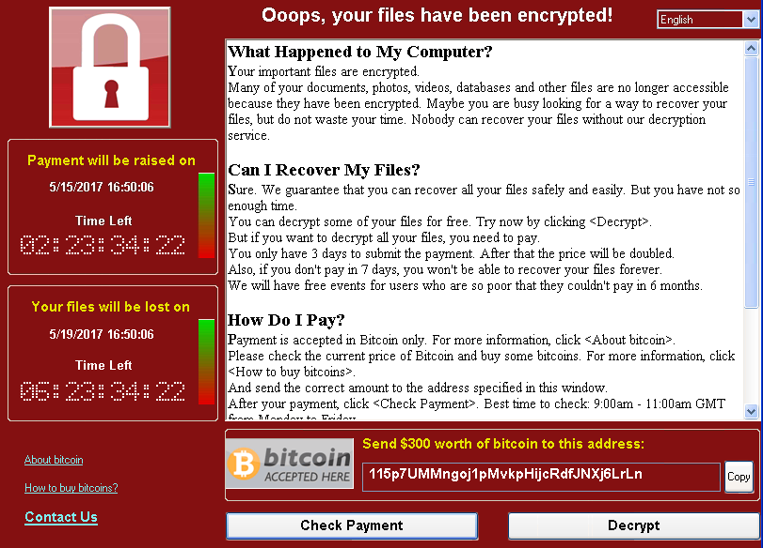
RansomWares - Wannacry Processing
Infect
Runs Attack if MS17-010 is not installed [ETERNALBLUE]
Encrypt
Encrypt 179 file types
Spread
Scans the local LAN and wider internet for port 445
Installs Trojan if attack is successful [DOUBLEPULSAR]
Attempt to infection if port if open
Shows the message and demand for payment using bitcoin.

Slide 8
RansomWares – Petya propagation
Use SMB ETERNALBLUE/ETERNALROMANCE vulenaribilites (for machine not already patched with MS17-010 security hotfix).
Use Mimikatz like program to proceed with identity thief, Pass-the-Hash, PSExec drop on admin$ share then performing remote calls.
Rely also on WMIC (Windows Management Instrumentation Command-line).

Slide 9
RansomWares – Petya propagation step-by-step
Run XOR hashing to check if malware already present. Otherwise install them.
Create scheduled task (using either at.exe or schtasks.exe)
Restart machine after around 10 minute
Modify MBR

Slide 10
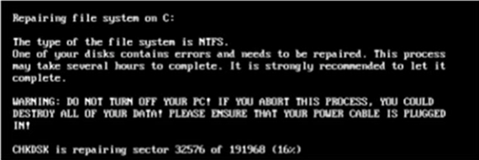
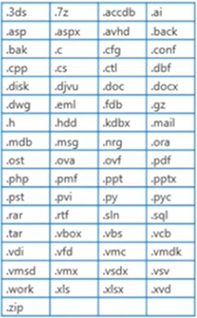
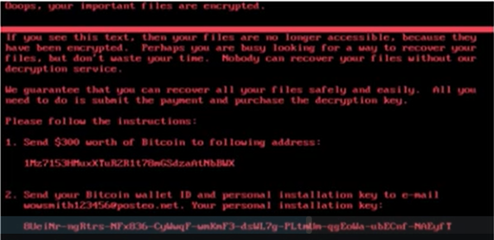
RansomWares – Petya propagation step-by-step
Run fake CHKDSK
Display bitcoin screen
Encrypted files on disk
AES algorithm used with 800bits RSA public key

Slide 11
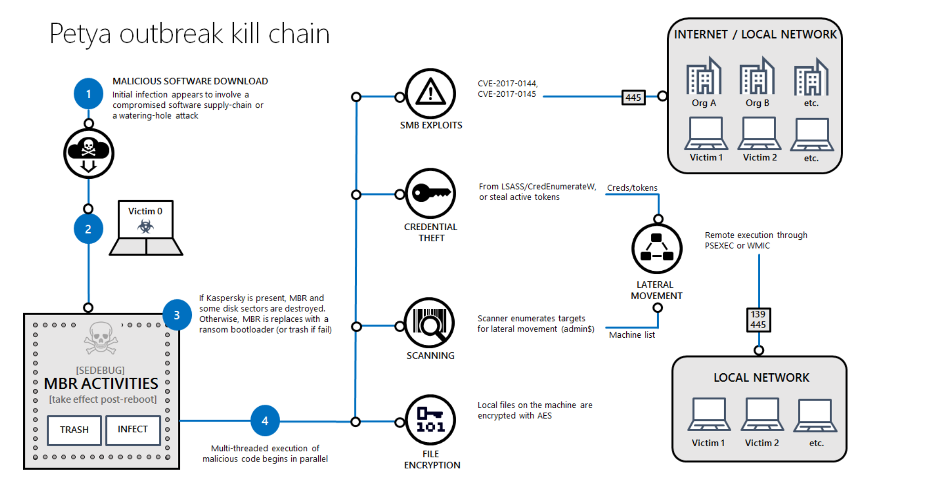
RansomWares – Petya

Slide 12
RansomWares: Countermeasures

Slide 13
RansomWares how to detect
Malware will try to start with system. Need to check:
C:\users\XXXX\appdata\
C:\users\XXXX\appdata\Local
C:\users\XXXX\appdata\Local\Temp
C:\users\XXXX\appdata\Roaming
HKCU\Software\Microsoft\Windows\CurrentVersion\Run
HKLM\SOFTWARE\Microsoft\Windows\CurrentVersion\Run
Using Process Explorer with Virus Total:
Impacted machine need to have Internet Access
http://www.sevenforums.com/tutorials/345808-process-explorer-virustotal-check-all-processes-50-avs.html

Slide 14
RansomWares how to detect
Check behavior monitoring:
Understanding real-time protection options : https://technet.microsoft.com/en-us/library/ff823769.aspx
Using System Center Endpoint Protection : https://technet.microsoft.com/en-us/security/jj900682.aspx or Windows Defender
Enhancements to Behavior Monitoring and Network Inspection System in the Microsoft anti-malware platform : http://blogs.technet.com/b/configmgrteam/archive/2013/06/24/enhancements-to-behavior-monitoring-and-network-inspection-system-in-the-microsoft-anti-malware-platform.aspx

Slide 15
RansomWares reaction
Put temporarily share folder in Read Only mode:
Identify shares with ShareEnum from Sysinternals: https://technet.microsoft.com/en-us/sysinternals/bb897442.aspx)
Or using PowerShell script: https://gallery.technet.microsoft.com/scriptcenter/a231026a-3fdb-4190-9915-38d8cd827348
Enable security audit:
What's New in Windows Security Auditing : https://technet.microsoft.com/en-us/library/dd560628(v=ws.10).aspx
Security Audit Policy Reference : https://technet.microsoft.com/en-us/library/dd772623(v=ws.10)

Slide 16
RansomWares indentify source
If you have encrypted files in share:
Check file owner on encrypted file or ReadMe generated during encryption process (for example: Howtodecrypt.txt/.HTML or READ IF YOU WANT YOUR FILES BACK.HTML/.TXT).
To check owner, goto file Properties/security/advanced/owner
Most of the time the owner identity mach the ransomware identity in charge of encryption process
If owner is not relevant:
Compare file timestamp to logon (type 3 for network logon) events at the timestamp moment
https://blogs.msdn.microsoft.com/ericfitz/2008/08/20/tracking-user-logon-activity-using-logon-events/

Slide 17
RansomWares indentify source
If share is NAS:
Check logon ID on DC from NAS and matching file timestamp
If encryption still active: take port mirroring network trace (http://blogs.technet.com/b/kfalde/archive/2009/07/23/dealing-with-malware-that-creates-exe-s-on-file-shares.aspx)
Once infected machine identify, isolate it from network.

Slide 18
RansomWares protection – educate and monitoring
Educate users:
http://www.microsoft.com/fr-fr/security/online-privacy/phishing-scams.aspx
Caution with attached files.
In case of suspicious sender: http://www.barracudacentral.org/lookups/lookup-reputation
Do not accept application launch while opening the attached file
Scan with Antivirus:
https://support.microsoft.com/en-us/help/14210/security-essentials-download
Ensure you use the latest definition update: https://www.microsoft.com/en-us/wdsi/definitions

Slide 19
RansomWares protection - backup
Rely on backups:
Like Shadow Volume Copy or System Restore if still active
Otherwise you can use Previous versions of files or Restore files or folders using File History (Windows 8.1).
For servers, the safer is to use ‘offline’ backup solution to ensure it cannot be encrypted: http://www.backupassist.com/blog/support/cryptolocker-and-the-backup-impact/

Slide 20
RansomWares protection – Proactive steps
Update system and application components:
Review SIR updates (security Intelligence Report) to retrieve attack information:
http://www.microsoft.com/security/sir/default.aspx
Prevent as much as possible local admin privileges to user accounts
This is a key point to prevent identity thief
Prevent domain admin account

Slide 21
RansomWares protection – Office macros
One of the most frequent attack is thru office document containing malicious macro automatically executed at document start.
Disable auto start for macros: https://support.office.com/en-ZA/Article/Enable-or-disable-macros-in-Office-documents-7b4fdd2e-174f-47e2-9611-9efe4f860b12#bm2
But user still can activate this macro. So we also recommend to configure "Trusted Location" policy to allow execution only for configured path: https://support.office.com/en-us/article/Add-remove-or-change-a-trusted-location-7ee1cdc2-483e-4cbb-bcb3-4e7c67147fb4?CorrelationId=cd218d92-02cf-427b-806c-59f6a7c22809&ui=en-US&rs=en-US&ad=US

Slide 22
RansomWares protection – Office 2016 and macros
Office 2016 provide better protection against malicious macros with GPO settings:
https://blogs.technet.microsoft.com/mmpc/2016/03/22/new-feature-in-office-2016-can-block-macros-and-help-prevent-infection/

Slide 23
RansomWares protection – Filer Screening Management
Enable "File Screening Management" on Windows file servers
"File Screening Management" protect files and folders:
Preventing file creation using suffixes or extension depending on rules created.
Raise alerts for proactive monitoring
For exemple it’s possible to prevent *.encrypted file creation or any other file extension (which is not in whitelist)
https://technet.microsoft.com/en-us/library/cc732074.aspx
The basics of Windows Server 2008 FSRM (File Server Resource Manager) : http://blogs.technet.com/b/josebda/archive/2008/08/20/the-basics-of-windows-server-2008-fsrm-file-server-resource-manager.aspx
CryptoLocker – File Screens : http://www.catalyticit.com.au/cryptolocker-file-screens/

Slide 24
RansomWares protection – AppLocker
Enable AppLocker (or SRP Software Restriction Policy on XP/Windows 7 professionnal)
Most reliable protection against ransomwares in coordination with compressed files (containing executables) and URL filtering at proxy and mail server level.
Allow to block or to authorize programs based on several criterias:
Collections (extensions)
File version
Signatures
Path
For users or groups
More info: https://docs.microsoft.com/en-us/previous-versions/windows/it-pro/windows-server-2008-R2-and-2008/dd759068(v=ws.11)

Slide 25
RansomWares protection – AppLocker
Implementation:
http://www.microsoft-desktop.com/2011/03/applocker-implementation-et-configuration/
https://community.spiceworks.com/how_to/59664-free-almost-perfect-malware-protection-with-gpo-app-locker
https://4sysops.com/archives/stopping-cryptolocker-and-other-ransomware/
Caution: AppLocker can also block legitimate application. You can use exceptions:
https://technet.microsoft.com/en-us/library/dd759051.aspx

Slide 26
RansomWares protection – AppLocker
Most used Cryptolocker and Malware path/extension:
%OSDRIVE%\Users\*\AppData\Local\Temp\*.tmp
%OSDRIVE%\Users\*\AppData\*\*.tmp
%temp%\*.tmp
%OSDRIVE%\Users\*\AppData\Local\Temp\*.exe
%OSDRIVE%\Users\*\AppData\*\*.exe
%temp%\*.exe

Slide 27
RansomWares protection – Exchange rules
Enable strong filtering in Office365
Most of malware relies on auto execution.
This can be blocked at Exchange online level through transport rule to block or flag mails containing exe
Filtering engine based on file extension blacklist and on file scanning to detect file type and define if it is executable or not.
http://blogs.msdn.com/b/tzink/archive/2014/04/08/blocking-executable-content-in-office-365-for-more-aggressive-anti-malware-protection.aspx
Same on Exchange on-premise configuring strong filtering rule for transport (for example filter zip files, etc)

Slide 28
RansomWares protection – Exchange EOP
Protection based on EOP (Exchange Online Protection). More information:
Exchange Online Protection overview : https://technet.microsoft.com/en-us/library/jj723119(v=exchg.150).aspx
Best Practices for configuring EOP : https://technet.microsoft.com/en-us/library/jj723164(v=exchg.150).aspx
Configure content filter policies : https://technet.microsoft.com/en-us/library/jj200684(v=exchg.150).aspx
Using transport rules to inspect message attachments : http://blogs.technet.com/b/exchange/archive/2009/05/11/3407435.aspx or https://technet.microsoft.com/en-us/library/jj919236(v=exchg.150).aspx

Slide 29
RansomWares protection – Exchange Online ATP and Firewall/Proxies
Using Exchange Online Advanced Threat Protection (ATP)
This Exchange online feature allows to execute unknown signature attached file in sandbox environment in order to define if this file healthy or not:
https://products.office.com/en-us/exchange/online-email-threat-protection
At Firewall or proxy level: implement URL filtering
Example for TMG: https://technet.microsoft.com/en-us/magazine/ff472472.aspx

Slide 30
RansomWares protection – PUA in SCEP
Enable PUA (Potential Unwanted Application) in SCEP
PUA represent an application which can increase malware infection risk
See more: https://blogs.technet.microsoft.com/mmpc/2015/11/25/shields-up-on-potentially-unwanted-applications-in-your-enterprise/
Caution : this will detect only new PUA and does not detect PUA already present on system.

Slide 31
RansomWares protection – Useful documentation
Security TechCenter
https://portal.msrc.microsoft.com/en-us
Microsoft threat intelligence archive
https://www.microsoft.com/en-us/wdsi/research/antimalware-security-research-papers
Microsoft Security Advisories
https://technet.microsoft.com/en-us/security/advisories

Slide 32
RDP Hijacking

Slide 33
Hijacking rdp session
Need local administrator privileges to gain system rights.
There are no external tools. Nothing to get through application whitelisting. No executable is written to disk.
Works on almost all versions of Windows operating system.
you can connect to any session without a password.

Slide 34
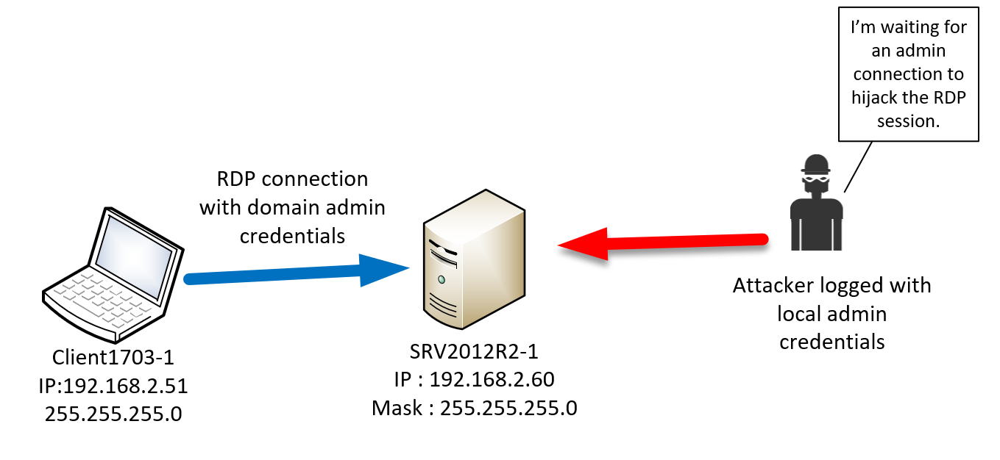
Goal

Slide 35
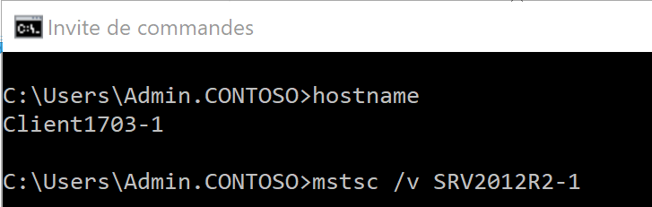
RDP connection to SRV2012R2-1
From Client1703-1 workstation,
an administrator initiate RDP
connection to SRV2012R2-1 with
an account with domain
admins privileges.
Key
Key

Slide 36
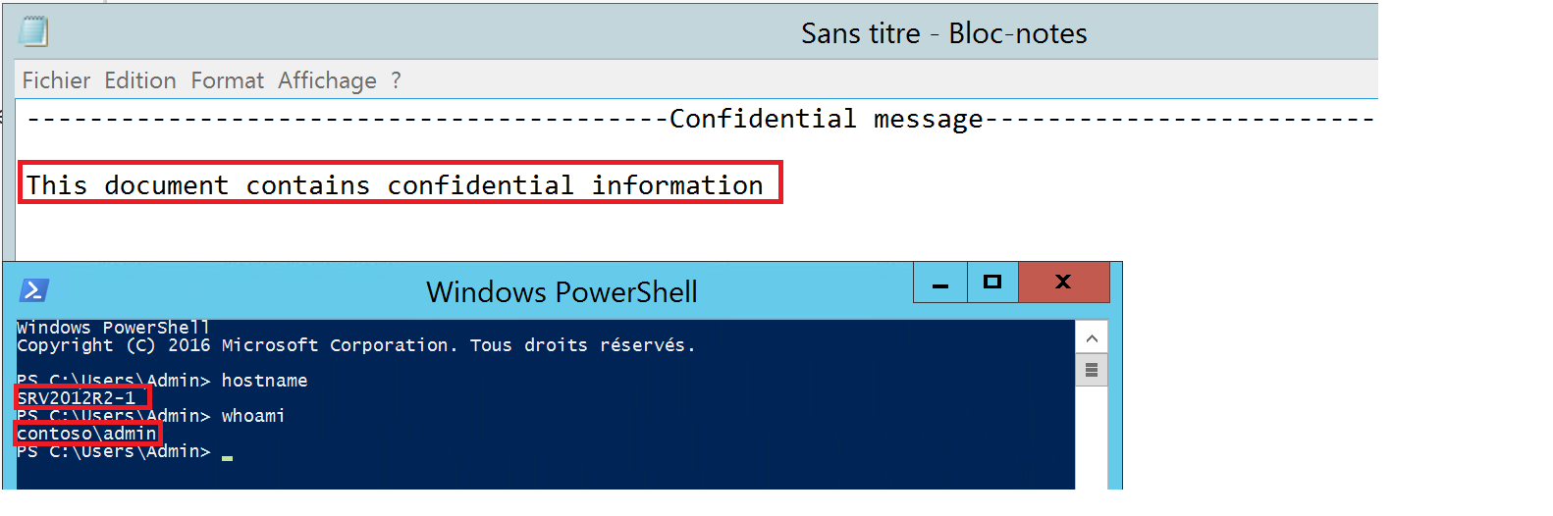
RDP connection to SRV2012R2-1
Administrator is connected to
SRV2012R2-1 and is working on a
confidential document.
Key
Key

Slide 37
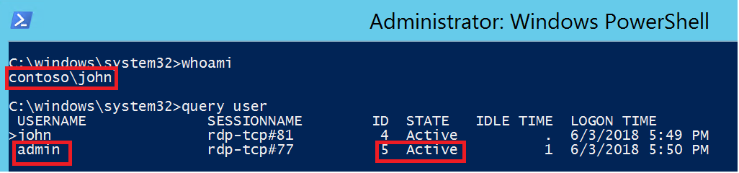
List all connected user
Connected on SRV2012R2-1
with a domain account “john” with
local admin privilege,
the attacker started “cmd.exe” and
listed all connected users.
Now, the goal is to hijack
administrator session
Key
Key

Slide 38
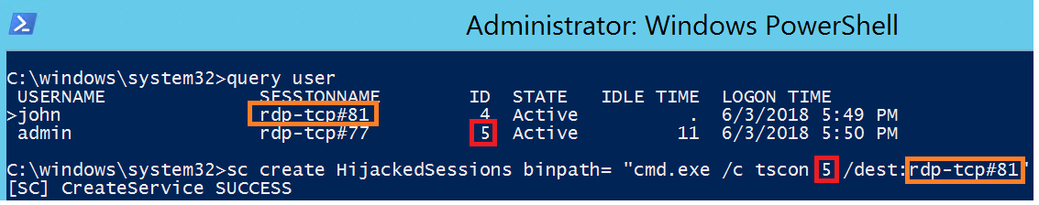
Create service
The attacker create service that
will disconnect active admin rdp
session and connect it to the
current rdp session.
The service will run as SYSTEM by
default
Key
Key

Slide 39
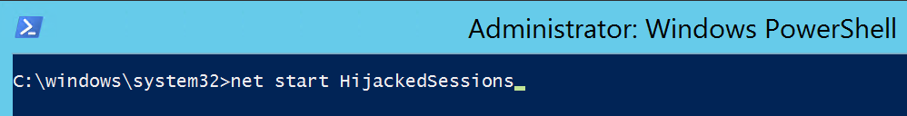
Start of the service
The attacker start the service.
Key
Key

Slide 40
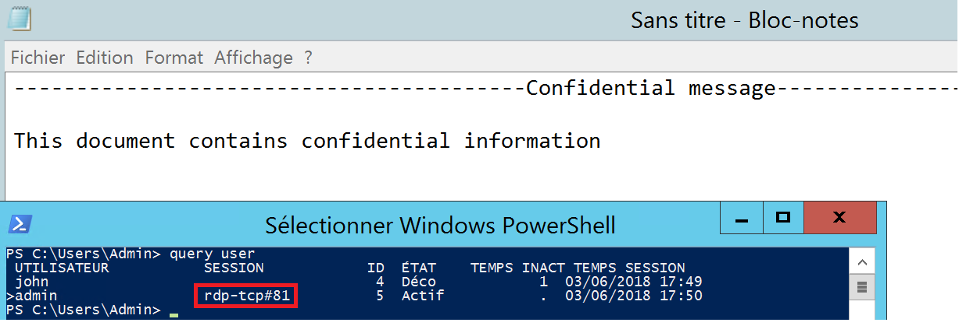
Access to confidential information
The attacker session has now
replaced with admin’s session. He
has now access to all confidential
information.
Key
Key

Slide 41
DLL Hijacking

Slide 42
Windows DLL
Dynamic-Link Libraries are collections of data and executable code that are used by other applications and DLL files. The main reasons for using DLL files instead of just putting the functions and data into the executable itself are to both make it easier to update the software (instead of requiring any user wishing to update to re-download the entire executable, you'd only need to re-download one or two small files. You can imagine how useful this is for designers of games that may need to be frequently updated) and to reduce excess memory usage by allowing the DLL file's code to be shared between applications.

Slide 43
DLL Hijacking
Sometimes a program may try to load a DLL that doesn’t even exist on the system.
The vulnerability is a simple one, it abuses how Windows loads DLLs when EXEs are executed and how default folder permissions work on Windows.
When the DLL fails to load, the code takes another path.
If you supply your own DLL, the app blindly loads it for you.

Slide 44
DLL Hijacking - Prerequisites
requires the software to be executed from a directory other than the protected directories
The vulnerability is a simple one, it abuses how Windows loads DLLs when EXEs are executed and how default folder permissions work on Windows.
Required Write Permissions on a system folder
Required Restart of the service

Slide 45
Default DLL Search Path Order (SafeSearch)
The directory from which the application loaded.
The system directory. Use the GetSystemDirectory function to get the path of this directory.
The 16-bit system directory. There is no function that obtains the path of this directory, but it is searched.
The Windows directory. Use the GetWindowsDirectory function to get the path of this directory.
The current directory.
The directories that are listed in the PATH environment variable. Note that this does not include the per-application path specified by the App Paths registry key. The App Paths key is not used when computing the DLL search path.

Slide 46
Bypass Windows restrictions

Slide 47
Native Tools to Bypass restrictions
Users have ways to bypass the traditional restrictions that can be implemented.
Default integrated tools :
The command line.
PowerShell.
Creating a .NET application that uses WMI or not, and then compiles it.
Creating a macro in an Office document.
The creation of a VBS script that uses, as appropriate, WMI.

Slide 48
GPO User
To block the GPO application, the blocked application must be prevented from reading restrictions in the registry.
Before Windows 7, it was possible to set the security of the registry keys where the restrictions are stored and to prevent the system from reapplying these rights. Since Windows 7 the system reapplies the rights. One of the simplest ways is to delete the keys regularly in the registry.
It is necessary to have administrator rights on his machine to be able to do it. The system contains the tools needed to bypass restrictions imposed by a policy. If users are administrators of their machine, group policies can almost all be bypassed or deleted.

Slide 49
GPO User
To prevent user-level restrictions from being applied, you can create a task or application that runs regularly to ensure that when the system automatically reapplies the restrictions, they will be quickly removed.
The majority of user blocking settings are here:
HKCU\Software\Microsoft\Windows\CurrentVersion\Policies
HKCU\Software\Policies
By deleting the contents of these keys, if these restrictions were at the user level, you will be able to change the firewall again, open the registry editor, change the screen saver, etc…

Slide 50
Registry
When the registry edition is blocked by Group Policy, it is not possible to run Regedit.exe or regedt32.exe.
PowerShell allows you to read information without problems. With administrator privileges on your machine, you can delete a registry key, for example the one that prevents us from starting Regedit.exe.
Example :

Slide 51
Countermeasures

Slide 52
Windows Defender Exploit Guard
Windows Defender Exploit Guard (Windows Defender EG) is a new set of host intrusion prevention capabilities for Windows 10, allowing you to manage and reduce the attack surface of apps used by your employees.

Slide 53
Four features in Windows Defender EG
1
Exploit protection can apply exploit mitigation techniques to apps your organization uses, both individually and to all apps. Works with third-party antivirus solutions and Windows Defender Antivirus (Windows Defender AV).
2
Attack surface reduction rules can reduce the attack surface of your applications with intelligent rules that stop the vectors used by Office-, script- and mail-based malware. Requires Windows Defender AV.
3
Network protection extends the malware and social engineering protection offered by Windows Defender SmartScreen in Microsoft Edge to cover network traffic and connectivity on your organization's devices. Requires Windows Defender AV.
4
Controlled folder access helps protect files in key system folders from changes made by malicious and suspicious apps, including file-encrypting ransomware malware. Requires Windows Defender AV.

Slide 54
Applocker – What is it ?
AppLocker is a technology built into business-focused editions of the Windows platform (Windows 7 and later and Windows Server 2008 R2 and later) that allows an organization to centrally manage the execution environment on their clients and servers
AppLocker implements a concept called “Application Whitelisting” – whereby applications, application installers, and scripts are prevented from running unless they are explicitly allowed by inclusion in a set of whitelisting rules

Slide 55
Applocker – What is it ?
AppLocker consists of a set of tools and services that control application execution on the desktop.
AppLocker builds on Software Restriction Policies, but makes it easier for administrators to create, maintain, monitor, and deploy application execution rules.
Only applications that are specifically allowed by AppLocker policy can execute on the desktop.
Allow users to run approved applications and software updates based on policies while preserving the requirement that only users with administrative credentials can install or run applications and software updates.
Prevent vulnerable, unauthorized applications from running in the desktop environment, including malware.

Slide 56
Applocker – What is it ?
The Windows security model uses access control lists (ACLs) to determine what actions subjects can take on objects
To run executable code, the security principal must have Read and Execute permissions on the object
AppLocker allows or blocks execution independently of ACLs
An executable file will be blocked whether it resides on an ACL-controlled NTFS volume, or a USB drive that is not controlled by ACLs
AppLocker is complimentary protection that ACLs alone cannot address

Slide 57
Applocker – What is it ?
AppLocker is not a replacement for antivirus software, but rather another layer of a Defense-in-Depth strategy

Slide 58
Implementing an application-control solution based on AppLocker provides :
1
Reduced security risk. The ability to prevent installation and running of unauthorized applications helps Microsoft IT prevent malware and unsupported applications from affecting computers that are connected to the corporate network.
2
Improved legal compliance. Because many peer-to-peer file-sharing applications can promote distribution of copyrighted material, AppLocker helps Microsoft IT conform to Digital Millennium Copyright Act regulations.
3
Improved system management. With AppLocker, Microsoft IT has an automated means to identify and disable unapproved applications. In addition, the powerful and flexible rules offer more options for effective desktop configuration management. For example, allow users to run approved applications and software updates based upon policies while preserving the requirement that only users with administrative credentials can install or run applications and software updates.
4
Reduced support costs. AppLocker prevents users from running applications that destabilize the desktop environment, and needlessly consume network bandwidth or otherwise affect the enterprise computing environment, which translates to a reduction in help-desk costs.

Slide 59
Applocker – What is it ?
AppLocker explicitly blocks the non-administrators with the following :
vssadmin.exe (Ransomware malware developers use it to delete the Volume Shadow Copies, but the most prevalent one is to use the vssadmin.exe Delete Shadows /All /Quiet command. The downside to renaming vssadmin.exe is that it has been discovered that the program is used by Windows when it performs scheduled restore points)
cipher.exe
syskey.exe
mshta.exe (blocks .HTA files)
IEEXEC.exe (The Microsoft .NET Framework)
InstallUtil.exe (.NET Framework)
Regsvcs.exe (.NET framework)

Slide 60
Windows Defender Application Guard
Application Guard helps to isolate enterprise-defined untrusted sites, protecting your company while your employees browse the Internet. As an enterprise administrator, you define what is among trusted web sites, cloud resources, and internal networks. Everything not on your list is considered untrusted.
If an employee goes to an untrusted site through either Microsoft Edge or Internet Explorer, Microsoft Edge opens the site in an isolated Hyper-V-enabled container, which is separate from the host operating system. This container isolation means that if the untrusted site turns out to be malicious, the host PC is protected, and the attacker can't get to your enterprise data.

Slide 61
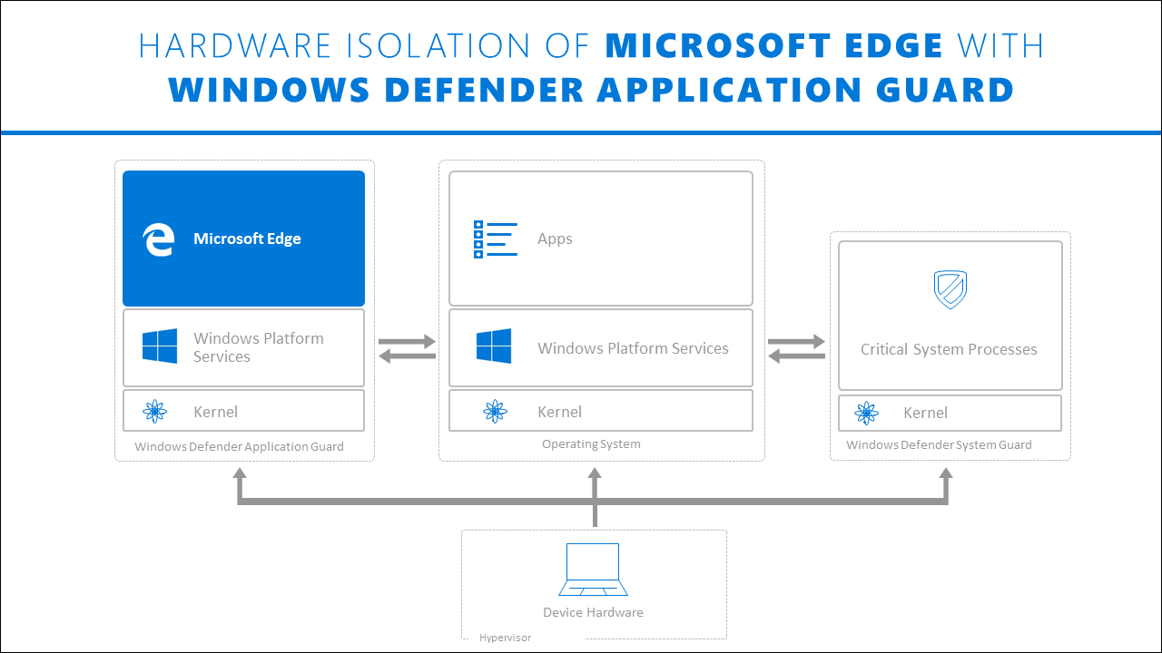
Windows Defender Application Guard

Slide 62
Devices should use Application Guard:
1
Enterprise desktops. These desktops are domain-joined and managed by your organization. Configuration management is primarily done through System Center Configuration Manager or Microsoft Intune. Employees typically have Standard User privileges and use a high-bandwidth, wired, corporate network.
2
Enterprise mobile laptops. These laptops are domain-joined and managed by your organization. Configuration management is primarily done through System Center Configuration Manager or Microsoft Intune. Employees typically have Standard User privileges and use a high-bandwidth, wireless, corporate network.
3
Bring your own device (BYOD) mobile laptops. These personally-owned laptops are not domain-joined, but are managed by your organization through tools like Microsoft Intune. The employee is typically an admin on the device and uses a high-bandwidth wireless corporate network while at work and a comparable personal network while at home.
4
Personal devices. These personally-owned desktops or mobile laptops are not domain-joined or managed by an organization. The user is an admin on the device and uses a high-bandwidth wireless personal network while at home or a comparable public network while outside.

Slide 63
Documentation

Slide 64
Sources
ANSSI - Security of RDP
Book - Windows Internal Hacking and countermeasures
AppLocker-Guidance
Windows Defender Exploit Guard
DLL Search Order
Book - Ethical Hacking (Learns attacks to better defend yourself)

Slide 65
.
Section 7 – Hijacking the legitimate OS functions and components
Summary
Main attacks are performed using:
Ransomware
Malware
Main attacks are:
Hijacking
RDP Hijacking
DLL Hijacking
Windows Restrictions Bypass
Main countermeasures:
Protect account with privileges
WDEG and WDAG
AppLocker/SRP
Audit and Backup

